Slide 1
Retail Product Display and Recommendation for Improved Sales Performance
Presented by: Suebsakul Seangsakulthai
Last Updated: 05/05/2023

Slide 2
Table of Contents
Purpose
Insight
Conclusion
Appendix

Slide 3
Purpose

Slide 4
Purpose
Analyze patterns in product combinations in baskets, identify subsequent purchases of customers, evaluate the effectiveness of different display features, and share the insights to key stakeholders.

Slide 5
Insight

Slide 6
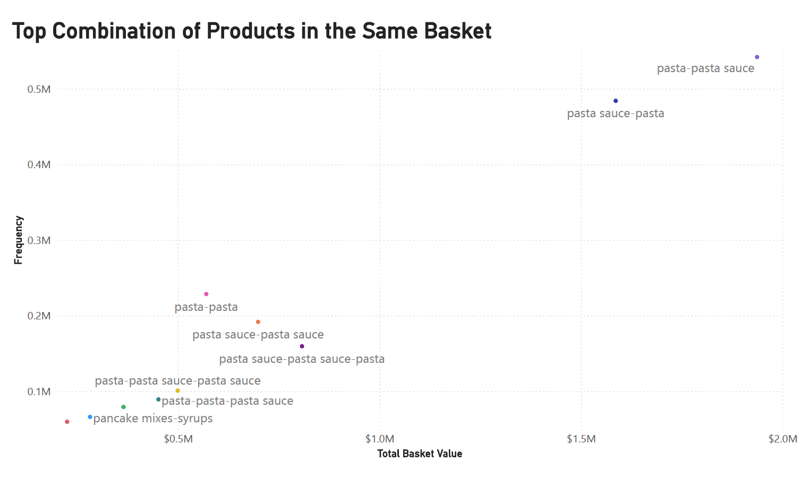
Pasta and pasta sauce combinations are the top performers.

Slide 7
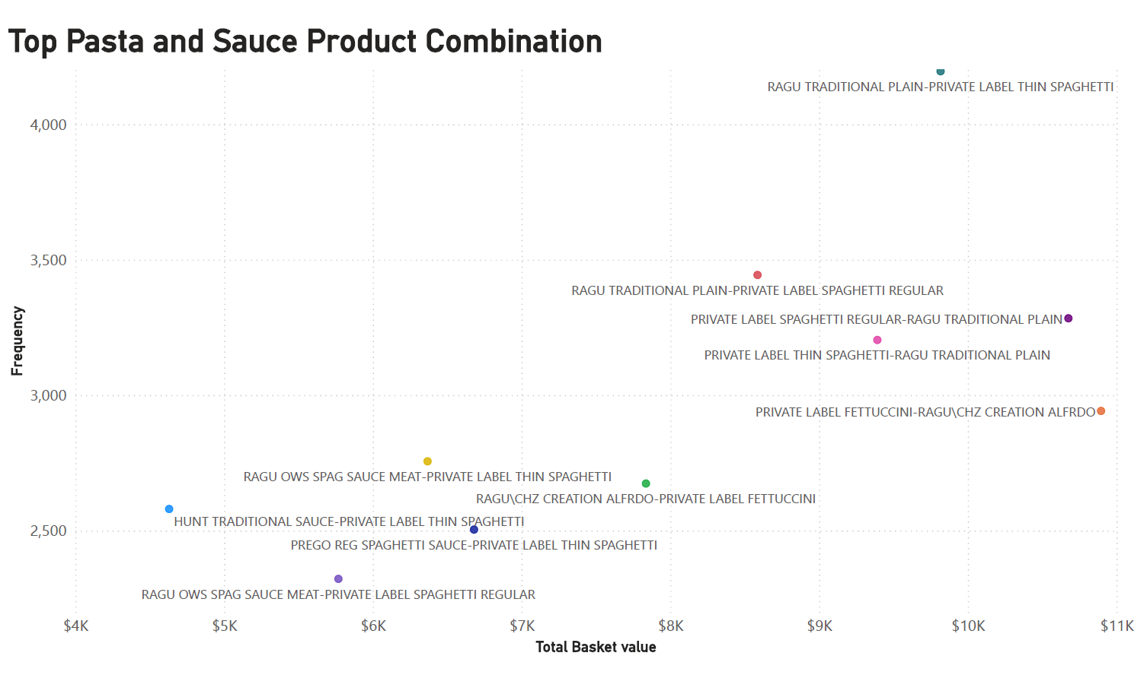
Focusing on pasta and pasta sauce combination, the top performing products are the combination of Ragu pasta sauces with Private Label pastas.

Slide 8
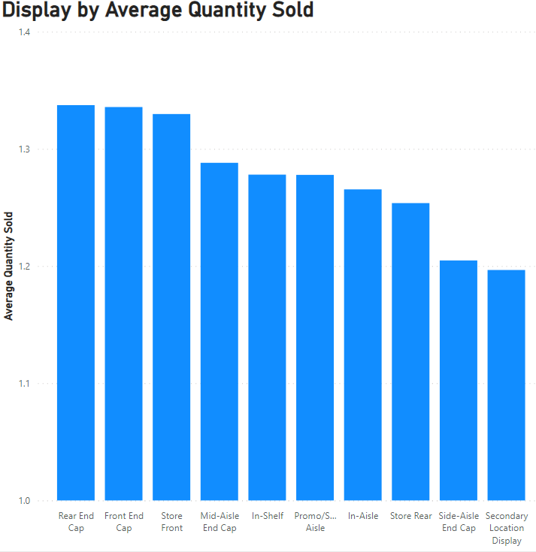
The way in which products are displayed can impact their sales. Specifically, it has been observed that the rear end cap, front end cap, and store front displays are particularly effective at driving quantity sold.
It would be interesting to investigate whether different product categories exhibit unique performance on different display features.

Slide 9
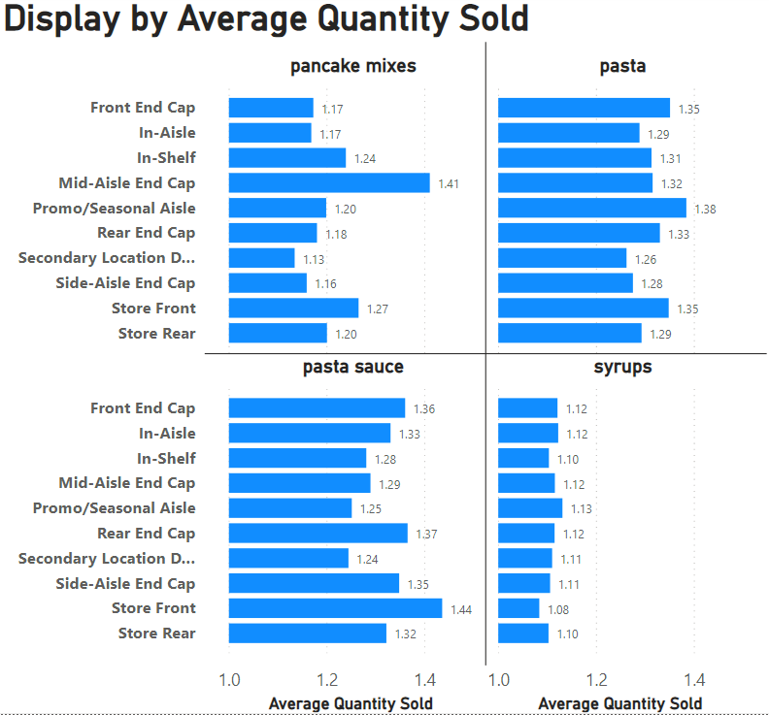
Each product category exhibits unique performance on different display features.

Slide 10
Insight
1. There is a notable link between the purchase of pasta and pasta sauce, with many customers tending to buy both products together. In fact, the combination of Private Label and Ragu is the most popular pairing among customers.
2. When it comes to promoting pasta and pasta sauce, the most effective displays are those located at the store front, front end cap, and rear end cap.
Displaying Private Label spaghetti and Ragu pasta sauce adjacent to one another at the store front, front end cap, or rear end cap, along with pair promotions or online basket recommendations, is likely to boost sales performance.

Slide 11
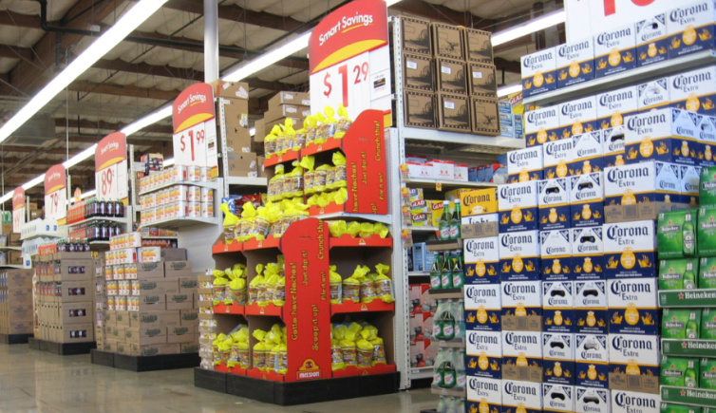
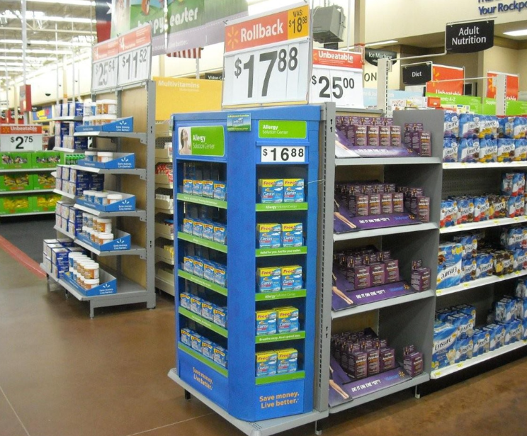
This insight appears to be reasonable, but there is a question that arises in the real world: Why do well-performing displays tend to showcase only one brand or product? Would it not be more advantageous for retailers to showcase high-potential product pairings instead? Does featuring only one brand in a high-performing display have an impact on the quantity of products sold?

Slide 12
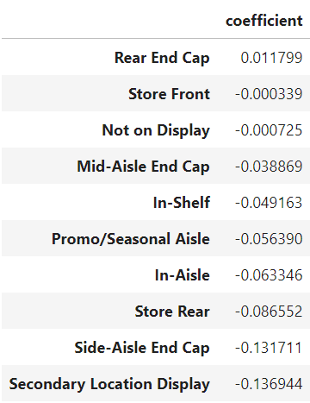
Upon training the Machine Learning Linear Regression Model, using the display as the input variable and the units sold as the output variable
the results indicate that the display has little impact on the number of units sold for a single product.
In other words, customers do not purchase a larger quantity of a single product based on whether it is displayed on a high-performing display or another type of display.

Slide 13
Conclusion

Slide 14
Conclusion
Displaying Private Label spaghetti and Ragu pasta sauce adjacent to one another at the store front, front end cap, or rear end cap, along with pair promotions or online basket recommendations, is likely to boost sales performance.
However, we also need to consider the cost of managing, workforce and I understand that the good performing displays are typically pay-to-display. Displaying more than one brand might lead to the decrease in pay-to-display income.
Further analysis to compare the total cost and income is necessary.

Slide 15
Appendix

Slide 16
Appendix
Each of the file below contains the detail of this analysis.
suebsakul_seangsakulthai_retail_analysis Power BI template and PDF – Analysis and visualization
suebsakul_seangsakulthai _retail_analysis Ipynb – Linear Regression model
suebsakul_seangsakulthai_log Excel File – Log record

